Slide 1
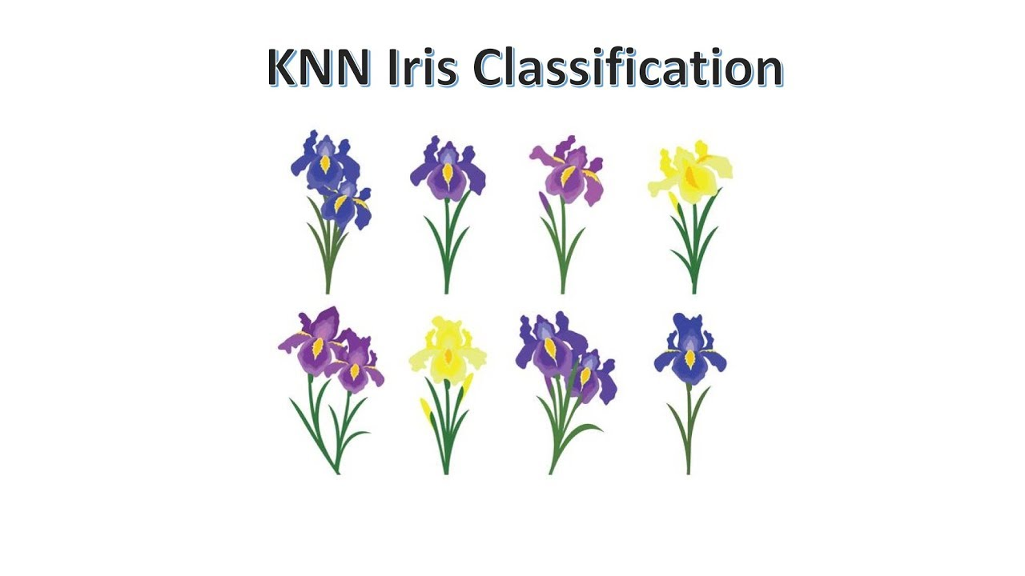
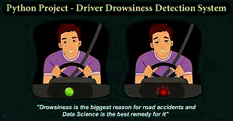
Project
Train and Give Inputs to a Machine Learning Model using KNN
Gadapwar Saiprasad
.....
....

Slide 2
Problem Statement
Machine learning is about prediction on unseen data or testing data and a set of algorithms are required to perform task on machine learning. There are three types of machine learning are called as Supervised, Unsupervised and Reinforcement learning. In this project we have worked on supervised learning.
We have taken the iris dataset and used K-Nearest Neighbors (KNN) classification Algorithm. Our purpose is build the model that is able to automatically recognize the iris species. Tools used for are Numpy, Pandas, Matplotlib .

Slide 3
Project Design
In this project we mainly focus on how KNN (K-Nearest Neighbors) algorithm works and implementation of KNN on iris data set and analysis of output.
The approach we will be using for this Python project is as follows :
1. Load the data
2. Analyze and visualize the dataset
3. Model training.
4. Model Evaluation.
5. Testing the model.

Slide 4
Data Collection and Preprocessing
The dataset used for this model is Iris dataset which has been taken from kaggle website.
The dataset consists of 5 columns(i.e 4 ordinal attributes(SepalLength,SepalWidth,PetalLength,PetalWidth) and 1 categorical attribute(Species).
In the DataPreparation state , x variable is assigned with ordinal attributes and y variable is assigned with categorical attribute which is training the dataset .The training dataset is preprocessed with StandardScaler module.

Slide 5
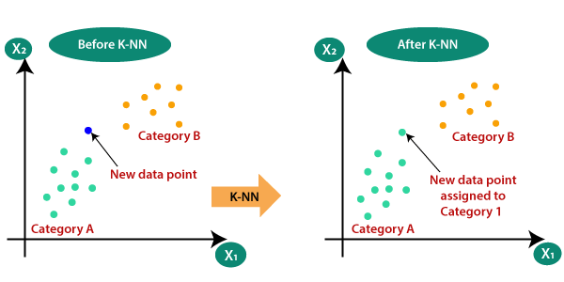
Machine Learning Models
K-Nearest Neighbours Algorithm
The k-nearest neighbors algorithm, also known as KNN or k-NN, is a non-parametric, supervised learning classifier, which uses proximity to make classifications or predictions about the grouping of an individual data point. While it can be used for either regression or classification problems, it is typically used as a classification algorithm, working off the assumption that similar points can be found near one another.

Slide 6
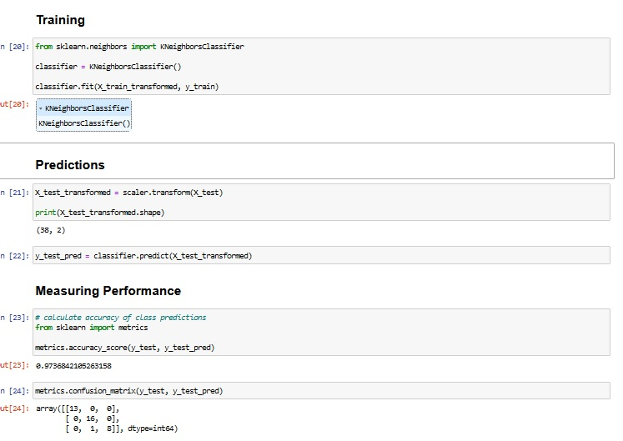
Project Output
Classification Using KNN:

Slide 7
Future Scope and Usability
It's easy to understand and simple to implement
It can be used for both classification and regression problems
It's ideal for non-linear data since there's no assumption about underlying data
It can naturally handle multi-class cases
APPLICATIONS:-
Many companies make a personalized recommendation for its consumers, such as Netflix, Amazon, YouTube, and many more.
KNN can search for semantically similar documents. Each document is considered as a vector. If documents are close to each other, that means the documents contain identical topics.
KNN can be effectively used in detecting outliers. One such example is Credit Card fraud detection.

Slide 8
Project Data Links
Project Code / Colab Notebook / Public Github Link
Project Video Link

Slide 9




www.hexart.in
Sponsored by
THANK YOU
CSR Partner
Implementation Partner

